Slide 1
Introduction to
Web-APIs
Github: https://github.com/ashish-mw/workshop-webapis

Slide 2
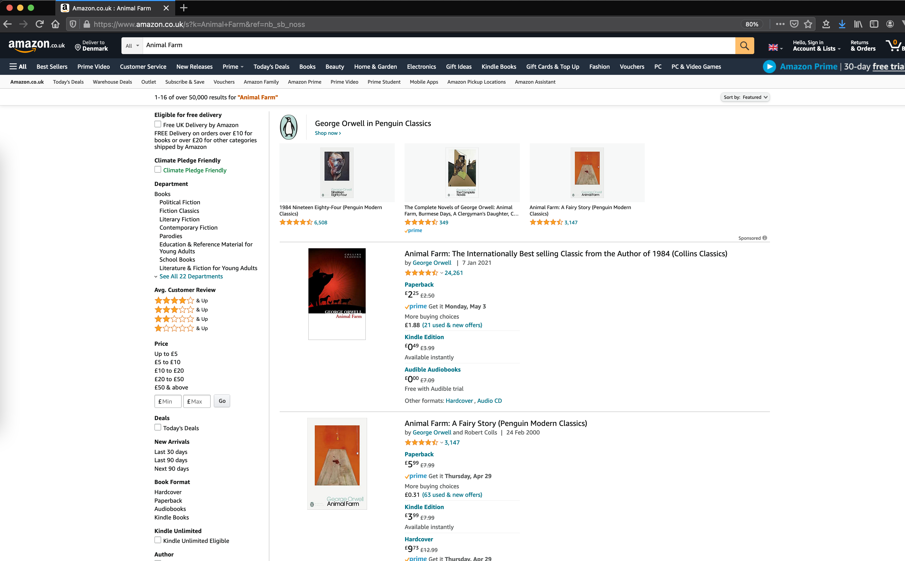
Websites
Display data in HTML as browsers can only understand HTML

Slide 3
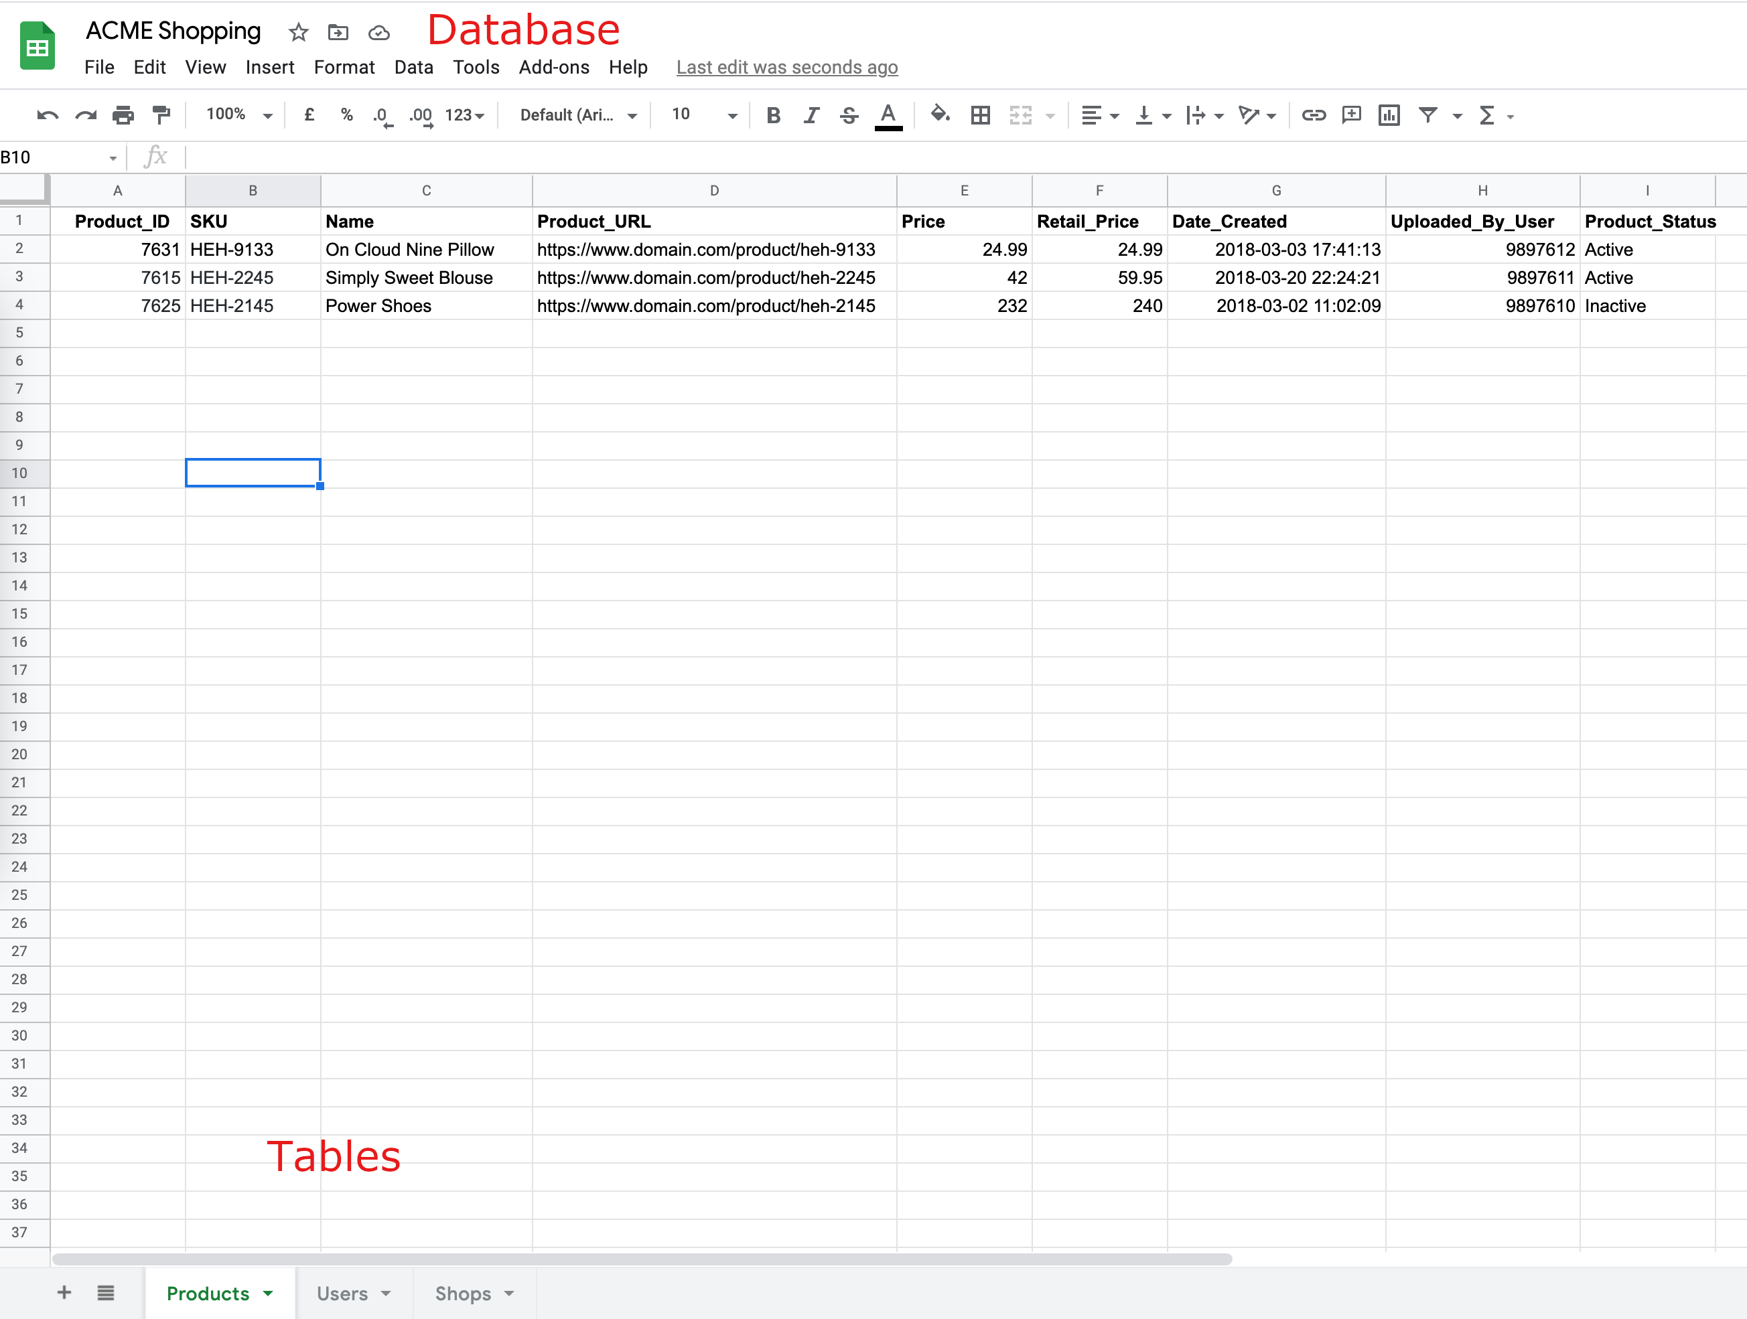



Databases/DBMS
A program that helps us organise data.

Slide 4
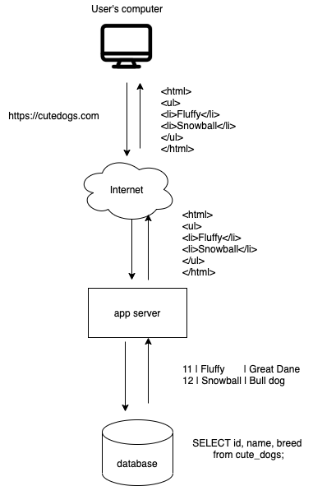



Websites
We mean “dynamic” websites or web apps.
A web server takes data from a database.
Makes HTML.
Gives it to the browser to display.

Slide 5
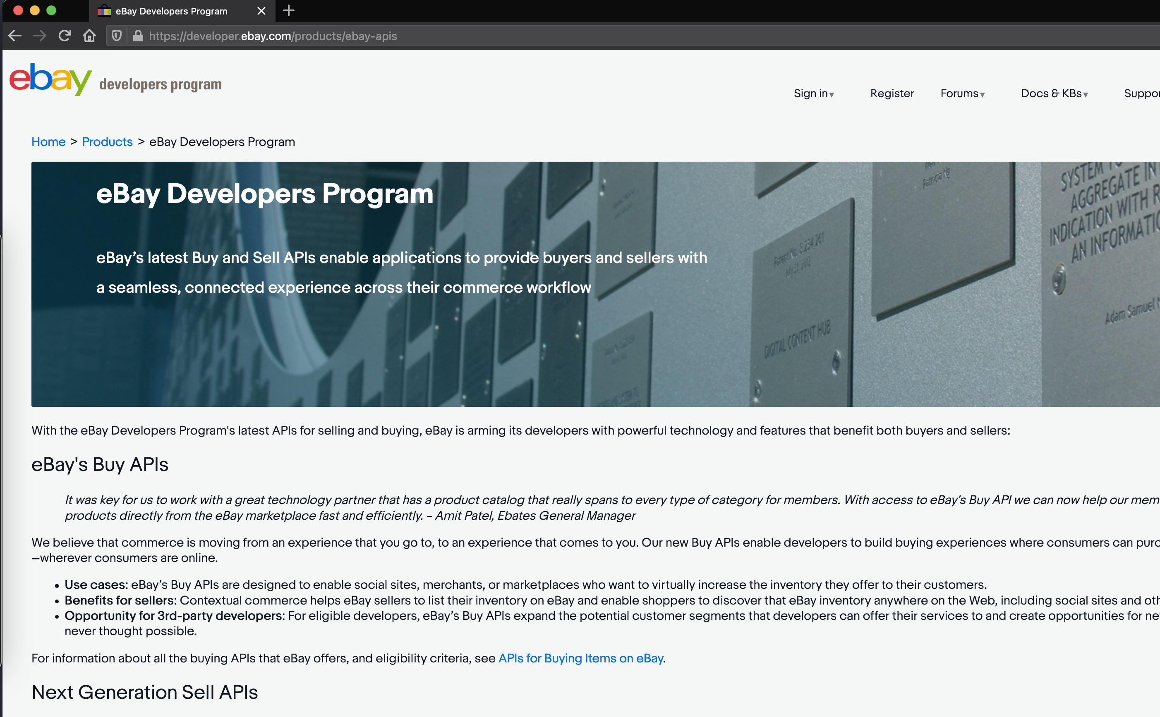
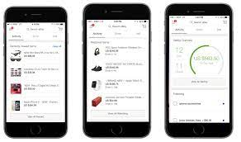
What if?
We want to share just the data from acme.com to smith.com?
- We want to display our data not just on our website?

Slide 6
The solution
Make websites give out just the data with API endpoints.
Allow applications to consume that data and display however they like it.
The application can be another web app or even a mobile app.
An API endpoint is just a URL that returns some data in a structured format for some resource
https://api.coronavirus.data.gov.uk/v1/data

Slide 7
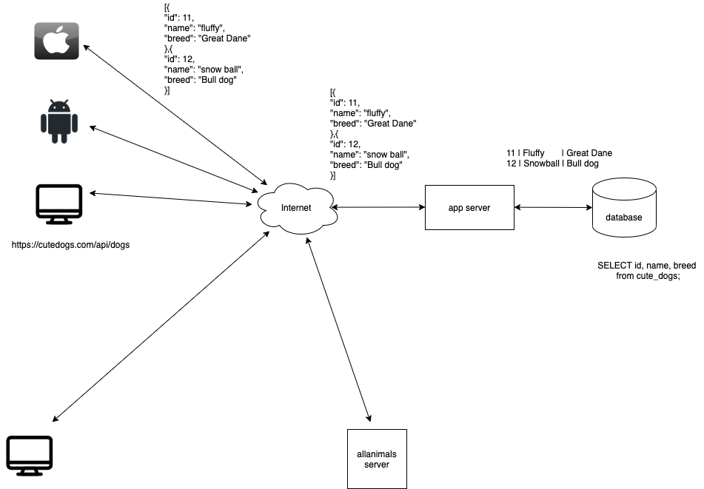
The solution - overview
https://allanimals.com/dogs

Slide 8
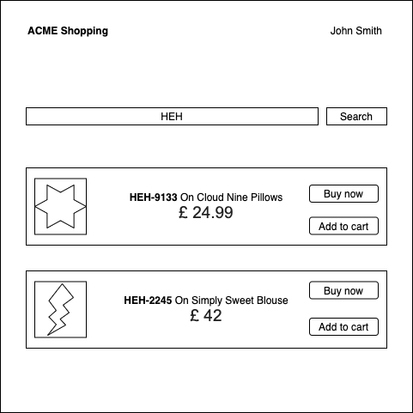
Example web app

Slide 9
Structured format

Slide 10
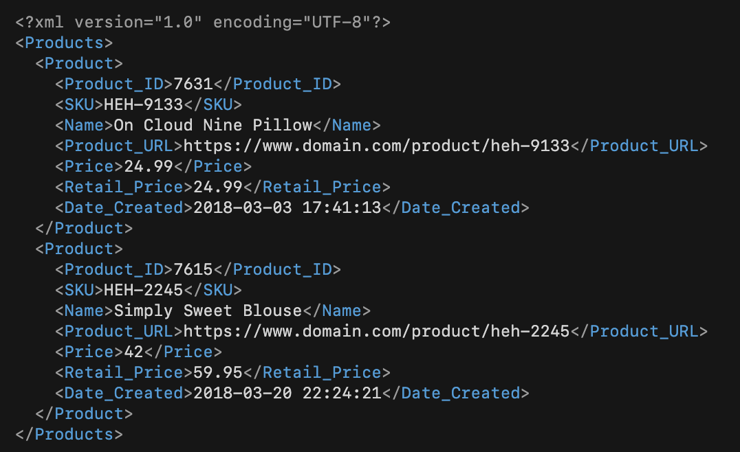

Structured format - XML
eXtensible Markup Language - SOAP
Where something starts and ends in a document == markup
Tags represent a data value

Slide 11
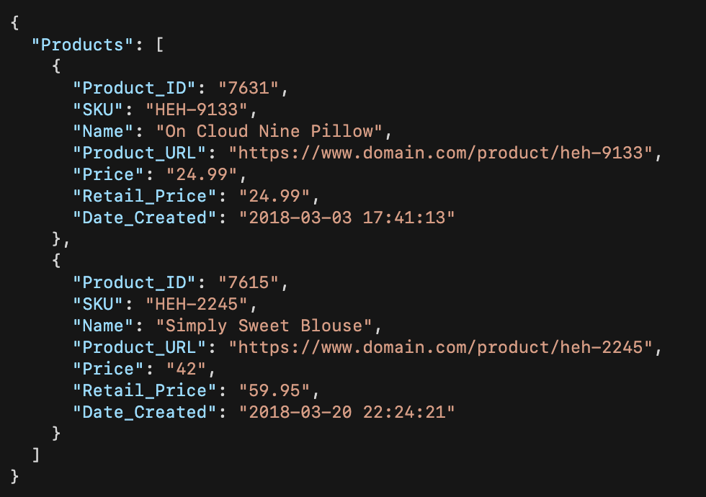

Structured format - JSON
JavaScript Object Notation - REST
Less emphasis on structure and simpler to work with.
Key-Value pairs represent a data value

Slide 12
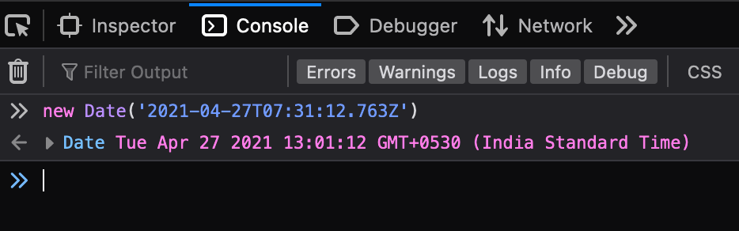
How to read?
{
"has_cod": true,
"min_delivery_date": "2021-04-27T07:31:12.763Z",
"orders_from": null,
"sales": 32
}
has_cod / hasCod / HasCod / has-cod / Has-Cod
The letter casing depends on the developer. But it’ll be consistent. The key simply states if the item
has Cash on Delivery available or not. What COD stands for will be mentioned in API documentation.
2021-04-27T07:31:12.763Z
Dates are usually mentioned with Timezone or in UTC format.
null
No data

Slide 13
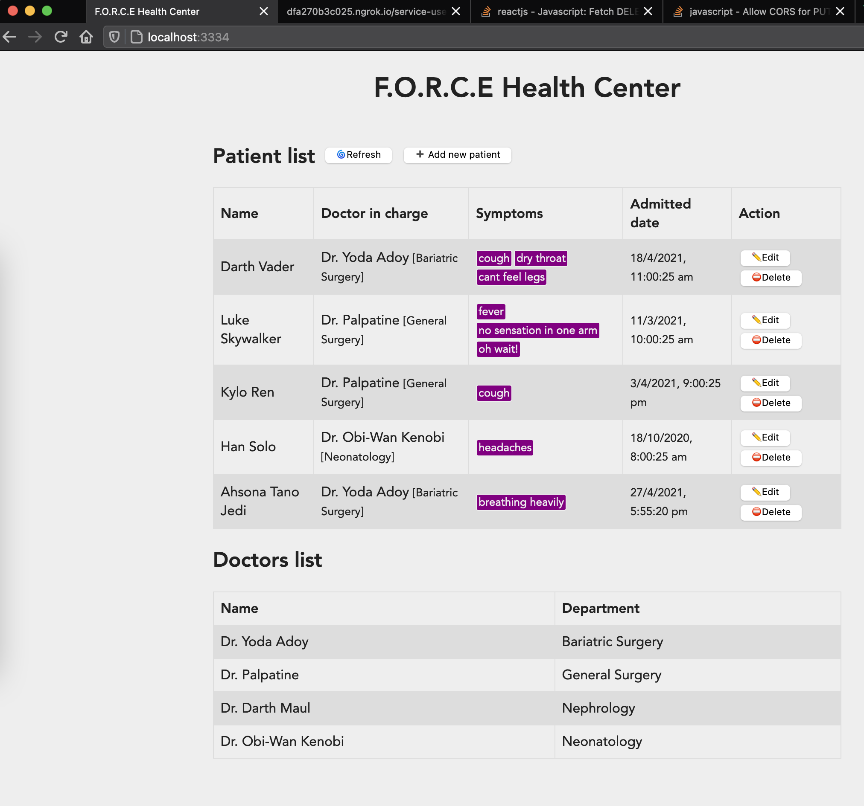
Demo
Sample API server
Sample web client

Slide 14
Questions?
https://github.com/public-apis/public-apis
https://public-apis.xyz
Slack: @ashish
Email: ashish@mindwaveventures.com

